Slide 1

Introduction to Network Traffic Analysis
Rebecca Deck, GSE, OSCE, CISSP
BE INFORMED. BE STRATEGIC. BE SECURE.
Notes:
Goal is to have a decent understanding of the basics and be able to do something useful

Slide 2
Overview
Part 1: The Basics
Part 2: Tools
Part 3: Common Protocols
Part 4: Scapy
Part 5: Analysis Tips
Part 6: Practical Exercise

Slide 3
Part 1 – The Basics

Slide 4
Overview Part 1 – The Basics
OSI & TCP/IP Model Overview
Hexadecimal Numbers
Binary Numbers
Ethernet Headers
IP Headers
TCP Headers
UDP Headers
ICMP Headers

Slide 5
Why Bother with Packet Analysis?
Faster than host-based forensics
Investigate networking alerts
Troubleshoot networking issues
Tell if tools are working
Reverse engineer protocols
Notes:
Blue team
Engineering
Application testing

Slide 6
The OSI Model
7. Application
6. Presentation
5. Session
4. Transport
3. Network
2. Data Link
1. Physical
Notes:
Was the de facto model until recently
Still used by many
Consistent references to “Layer 8” problems
Being replaced by TCP/IP model

Slide 7
The TCP/IP Model
7. Application
6. Presentation
5. Session
4. Transport
3. Network
2. Data Link
1. Physical
4. Application
3. Transport
2. Internet
1. Network Access
Notes:
TCP/IP along-side the OSI model
Much simpler representation
-doesn’t help with ideas like SSL/TLS
Will try to remember to use the TCP/IP model in references

Slide 8

Encapsulation
Example encapsulated HTTP request
Notes:
Encapsulation is going down the stack
Decapsulation is going back up
The payload and header of one level becomes the payload of the next lower level

Slide 9
Decimal in a New Light
8080
10⁰ = 1
10¹ = 10
10² = 100
10³ = 1000
10⁴ = 10000
10³ | 10² | 10¹ | 10⁰
Notes:
Can’t move on to headers without understanding binary and hex numbers
Rarely need to go over 65535
Decimal can help make sense of hex and binary
Each column is just a base 10 power

Slide 10
Hexadecimal Numbers
Base 16 (normal counting is decimal, base 10)
Decimal to Hex : Divide by powers of 16, ignore remainders
Hex to Decimal : Multiply by powers of 16
Prefixed by 0x
Notes:
Hex to decimal and vice versa is a pain.
Decimal to hex, lots of divide, subtract, repeat
Hex to decimal is not so bad. Multiply each column by its power of 16

Slide 11
Counting in Hex
Decimal | Hex
1 | 1
2 | 2
3 | 3
4 | 4
5 | 5
6 | 6
7 | 7
8 | 8
Decimal | Hex
9 | 9
10 | A
11 | B
12 | C
13 | D
14 | E
15 | F
16 | 10
Notes:
More than 10 numbers. Arabic numerals (decimal) has 10
Use alphabet A-F to make up the difference
After F, start over at 1-0

Slide 12
Decimal to Hex Conversion
8080/4096 = 1.xxxx
8080-(4096*1) = 3984
3984/256 = 15.xxxx
3984-(15*256) = 144
144/16 = 9.0
16⁰ = 1
16¹ = 16
16² = 256
16³ = 4096
16⁴ = 65536
1 F 9 0
16³| 16² | 16¹ | 16⁰
Notes:
Commit powers of 2 and 16 to memory
Start with biggest power of 16, divide.
Subtract that power from the value
Repeat

Slide 13
Hex to Decimal Conversion
1 F 9 0
16⁰ = 1
16¹ = 16
16² = 256
16³ = 4096
16⁴ = 65536
16³| 16² | 16¹ | 16⁰
1(4096) + 15(256) + 9(16) + 0(1) = ?
4096+3840+144+0 = 8080
Notes:
Hex to decimal is straight multiplication by powers
Again, know the powers of 2 and 16 cold

Slide 14
Binary Numbers
Base 2
Decimal to Binary : Divide by powers of 2, ignore remainders
Binary to Decimal : Multiply by powers of 2
Hex to Binary : Direct conversion of bytes to bits
Binary to Hex : Direct conversion of bits to bytes
Notes:
Binary is the same. Just powers of 2
Never convert decimal to binary.
Use hex as an intermediate step.
Converting hex to binary is just converting bytes to bits
What does that mean?

Slide 15
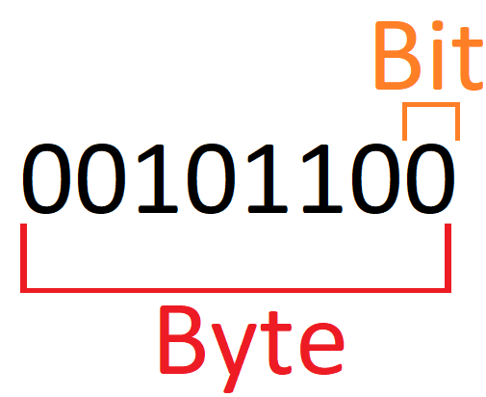
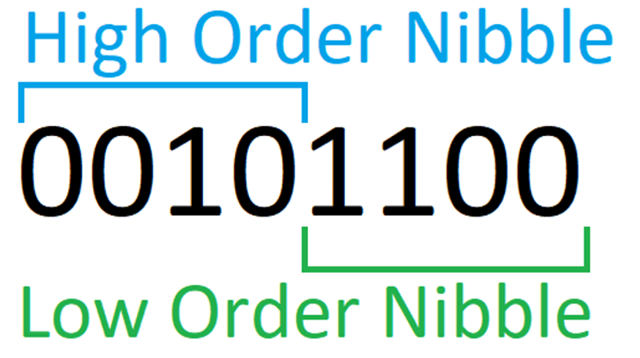
Bits, Bytes, and Nibbles
A bit is a single binary number, 1 or 0
A byte is 8 bits
A nibble is 4 bits
Notes:
Just normal terminology.
A bit is just a single pulse of electricity, a high or low voltage
Foundation of computing and data transfer

Slide 16
Counting in Binary
Decimal | Hex | Binary
1 | 1 | 0001
2 | 2 | 0010
3 | 3 | 0011
4 | 4 | 0100
5 | 5 | 0101
6 | 6 | 0110
7 | 7 | 0111
8 | 8 | 1000
Decimal | Hex | Binary
9 | 9 | 1001
10 | A | 1010
11 | B | 1011
12 | C | 1100
13 | D | 1101
14 | E | 1110
15 | F | 1111
16 | 10 | 00010000
Notes:
Binary counting is awkward at first
Kind of calm and relaxing
Mostly memorize 0-F conversions

Slide 17
Hex to Binary
1F90=
0001 1111 1001 0000
1 = 0001
F = 1111
9 = 1001
0 = 0000
Notes:
Simple. Convert the numbers from hex to binary and concatenate

Slide 18
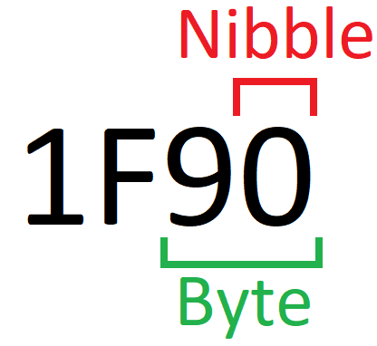
Hex Bytes and Nibbles
Nibble is a single hex digit
Byte is two hex digits
Notes:
Important for packet headers and addressing

Slide 19

Words
A word is 2 bytes (16 bits)
A double-word is 4 bytes (32 bits)
Often done in hex
Notes:
Common in memory addressing
Sometimes useful in packet headers
Values like ports and IP addresses

Slide 20
Knowledge Check
Convert CAFE to decimal
Convert 7A69 to binary
What is the high order nibble of the low order byte in binary?
What is the low order nibble of the high order byte in hex?

Slide 21
Knowledge Check - Answers
Convert CAFE to decimal – C=12, A=10, F=15, E=14
12(16³)+10(16²)+15(16¹)+14(16⁰) =
12*4096+10*256+15*16+14 = 51966
Convert 7A69 to binary – 0111 1010 0110 1001
What is the high order nibble of the low order byte in binary?
0110
What is the low order nibble of the high order byte in hex?
A

Slide 22
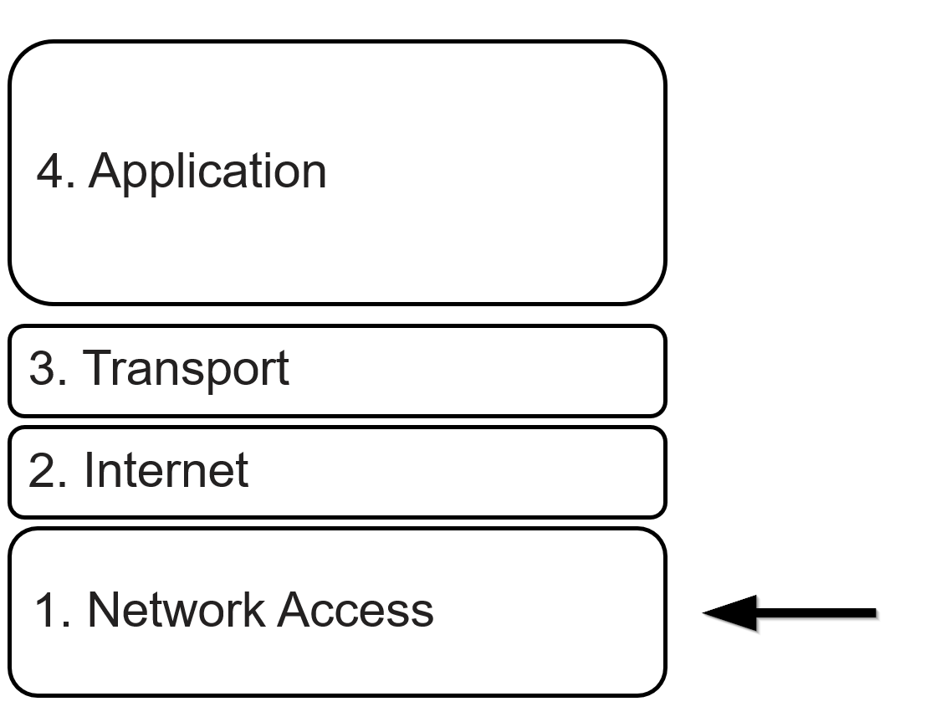
Network Access Layer
Common protocols: Ethernet, Wireless, Bluetooth
Ethernet & Wireless use Media Access Control (MAC) addresses
Information does not “route”

Slide 23
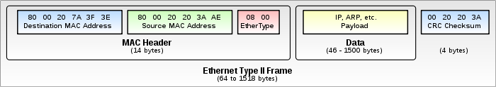
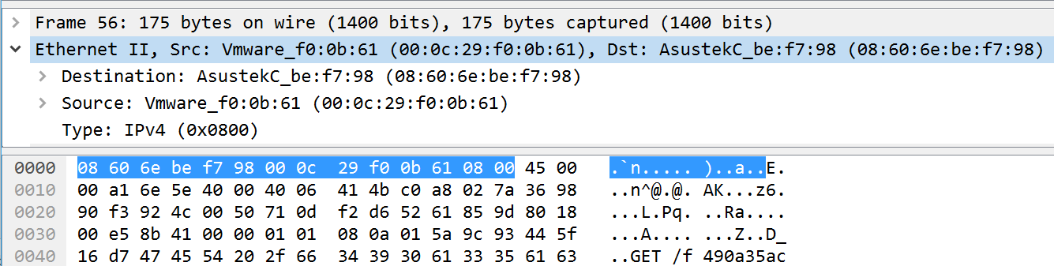
Ethernet Headers – Network Access Layer
Source: https://en.wikipedia.org/wiki/Ethernet_frame
Notes:
Not relevant in most forensics, most attacks, or most engineering issues

Slide 24
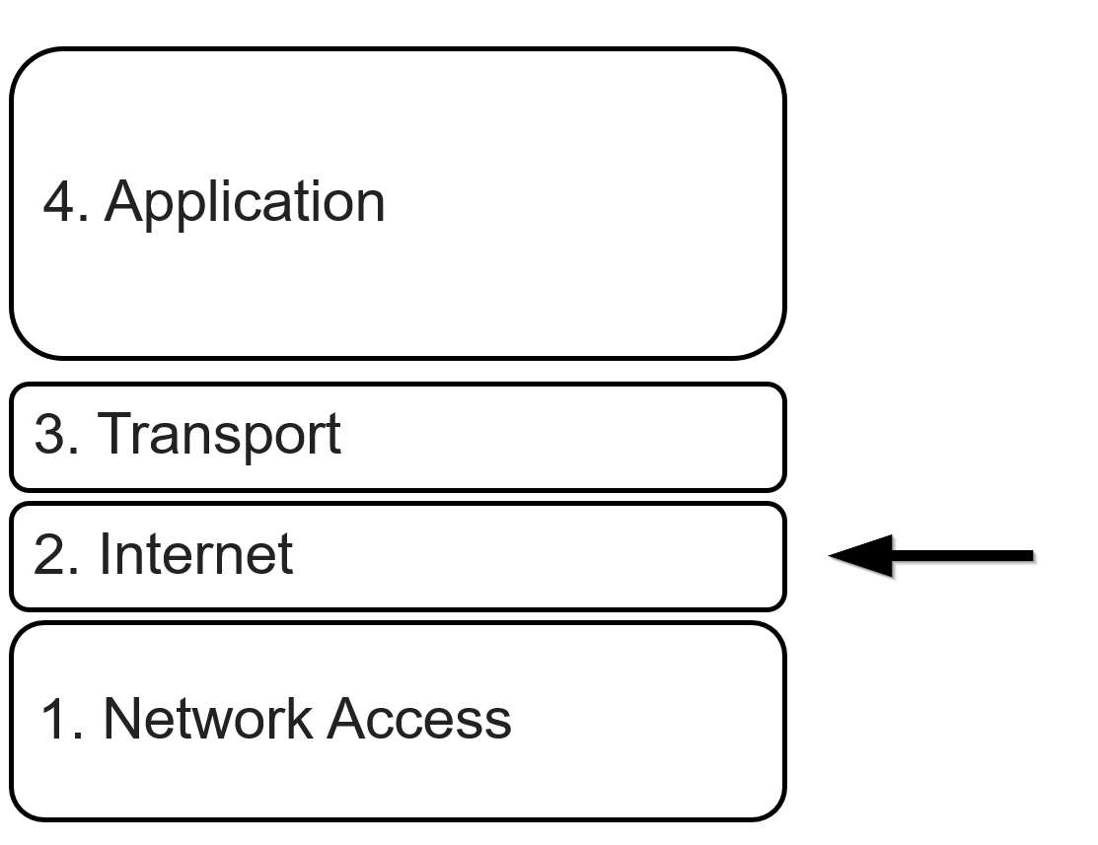
Internet Layer – IPv4
Routes packets across the internet
Uses 32-bit IP addresses
ARP resolves MAC to IP
Header length depends on options
Not that common
Does not guarantee delivery

Slide 25
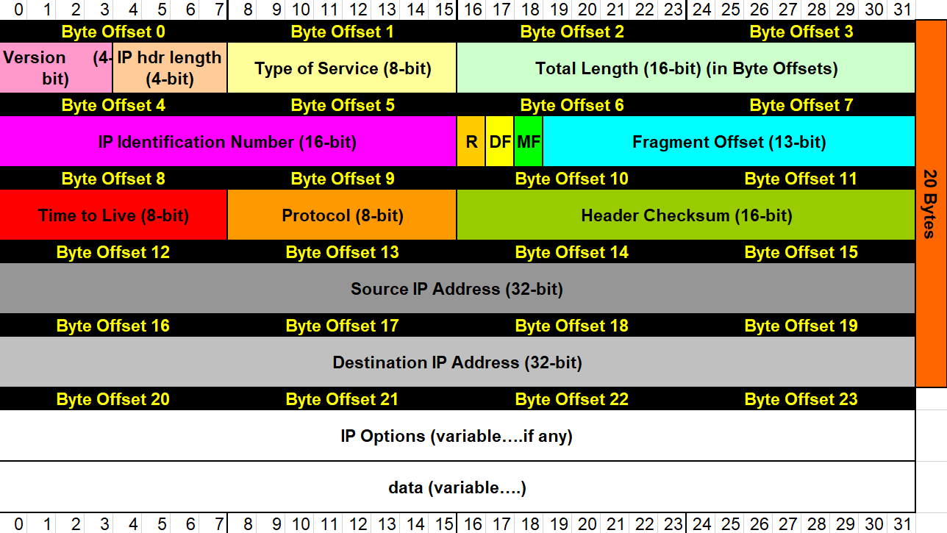
IPv4 Header – Internet Layer
http://wiki.gnhlug.org/twiki2/pub/Www/IpReference/Packet_Headers_Subnet_Breakdown.xls
Notes:
Mention fragmentation – covering if time permits
IP header length multiplied by 4 for length in bytes
Type of Service – aka differentiated services for ECN
TTL Router that changes it to 0 discards
Protocol field – determines transport-layer protocol
IP options – not common
Checksum just detects corruption – not discussing

Slide 26
IPv4 Fragmentation
Naturally occurs
Packet size exceeds MTU (Maximum Transmission Unit)
Sometimes orgs block it
Foundation for many bypass techniques
Observation point and target must decode the same way
RFCs do not deal with edge cases

Slide 27
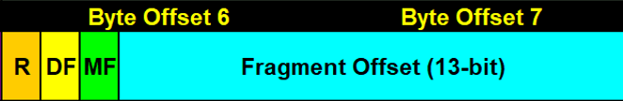
IPv4 Fragmentation
Fragments are in IP header, bytes 6 and 7
DF – Don’t Fragment
MF – More Fragments
Multiply fragment offset by 8, 13 bits cannot represent full packet length
MF bit set when more fragments follow (not in last frag or unfragmented packets)

Slide 28
IPv4 Fragmentation – Example (icmpfrag.pcap)
Payload per packet size = MTU-(IP header length)
Only first packet in the train has the transport protocol header
MTU of 1500 (Ethernet)
20 byte IP header
1480 payload bytes per packet
Packet 1 Offset : 0
Packet 2 Offset : 1480/8 decimal = B9 hex
Packet 3 Offset : 2960/8 decimal = 172 hex

Slide 29
IPv4 Fragmentation - Insertion
Observation system accepts data the target does not
cat /etc/
cat /etc/
derp
derp
Attacker
Observer
Target
shadow
shadow
cat /etc/derpshadow
cat /etc/shadow

Slide 30
IPv4 Fragmentation - Evasion
Observation system rejects data the target does not
cat /etc/
cat /etc/
Attacker
Observer
Target
shadow
shadow
cat /etc/
cat /etc/shadow

Slide 31
Traceroute
Find list of hops between hosts
Relies on ICMP Time Exceeded in Transit messages
Can use ANY layer 4 protocol
Send packets with variable TTL values
Each hop decrements TTL by 1, discarding router sends ICMP
Windows uses ICMP echo requests
Linux uses UDP 33434 to UDP 33534
Notes:
SYN with no response means blocked (firewall, IPS?)

Slide 32
Internet Layer – IPv6
Same purpose as IPv4
Uses 128-bit IP addresses
Neighbor Solicitation resolves MAC to IP
Does not guarantee delivery

Slide 33
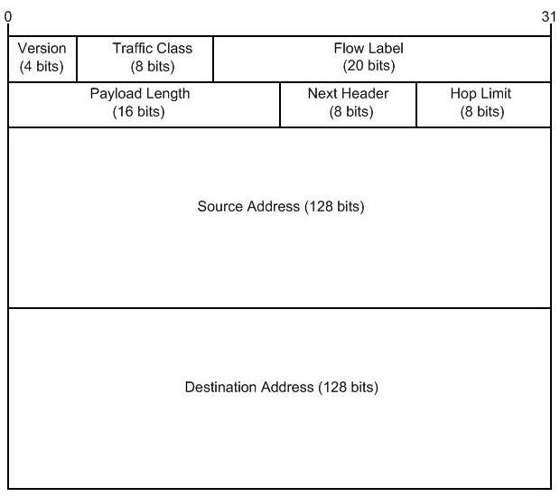
IPv6 Header – Internet Layer
https://www.cisco.com/c/en/us/about/security-center/countermeasures-ipv6-type-0.html

Slide 34
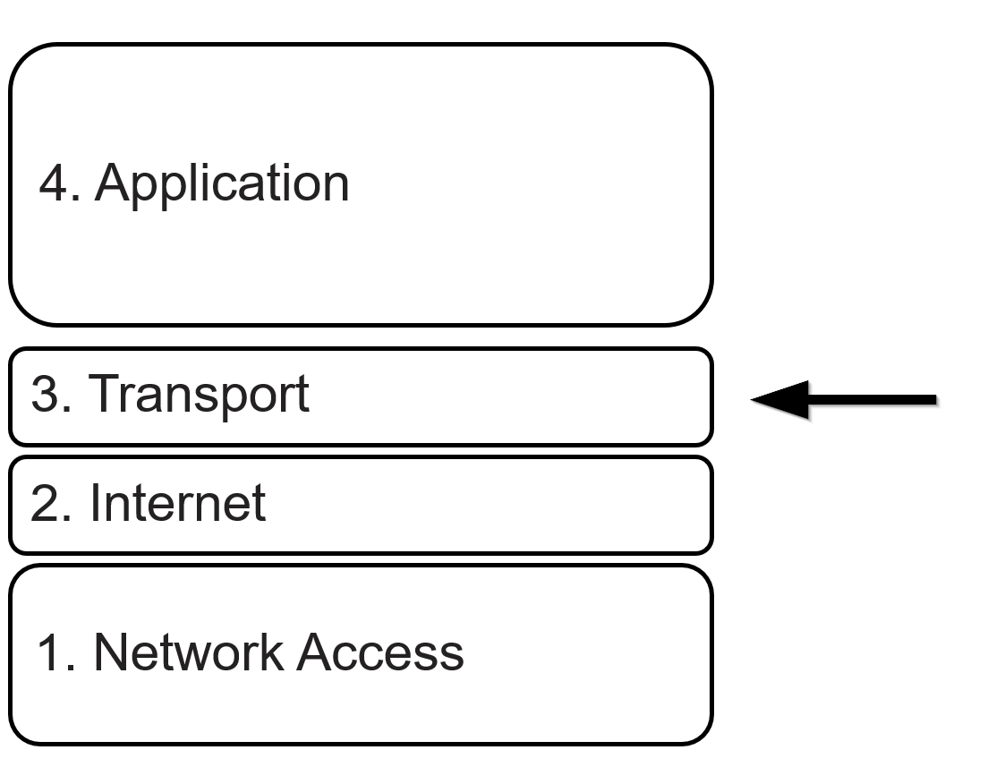
Transport Layer - TCP
Transmission Control Protocol
Ensures packet delivery
Most common transport layer protocol
Communication status controlled with TCP flags

Slide 35
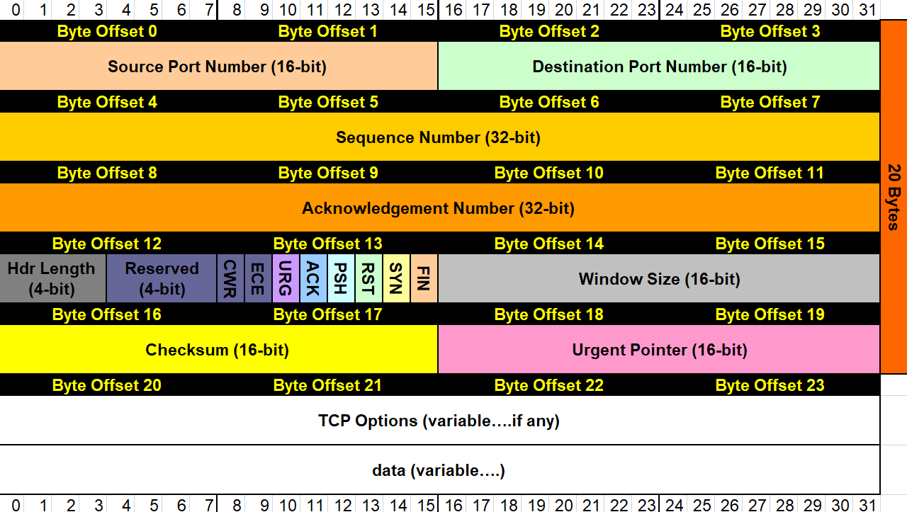
TCP Header
http://wiki.gnhlug.org/twiki2/pub/Www/IpReference/Packet_Headers_Subnet_Breakdown.xls
Notes:
Cover TCP flags
Mention TCP Options
Sequence number controls which conversation
Acknowledgement number controls where we are in conversation

Slide 36
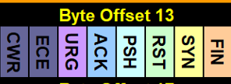
TCP Conversations - Beginning
SYN
SYN - ACK
Client
Server
ACK

Slide 37
TCP Conversations - Ending
RST
FIN-ACK
FIN - ACK
?
?
?
?
?

Slide 38
TCP - Tracking Conversations
Socket (Source – Destination combination)
Sequence Number
Client and server have different sequence numbers
Acknowledgement Number
Acknowledge last sequence # + payload length
Wireshark tracks this well

Slide 39
TCP - Tracking Conversations
C-S – Syn – SEQ 0x82acd14d ACK 0x00000000, no payload
S-C – Syn-Ack – SEQ 0x9696fd7e ACK 0x82acd14e, no payload
C-S – Ack – SEQ 0x82acd14e ACK 0x9696fd7f, no payload
C-S – Ack – SEQ 0x82acd14e ACK 0x9696fd7f, 306 byte payload
S-C – Ack – SEQ 0x9696fd7f ACK 0x82acd280, no payload
S-C – Ack – SEQ 0x9696fd7f ACK 0x82acd280, 1261 byte payload
C-S – Ack – SEQ 0x82acd280 ACK 0x9697026c, 286 byte payload
S-C – Ack – SEQ 0x9697026c ACK 0x82acd39e, 1460 byte payload

Slide 40
TCP - Retransmission
Blocked connections usually reset or dropped
Dropped packets look “lost” to host
Hosts retry at progressively larger intervals
Notes:
Important for scanning and troubleshooting

Slide 41
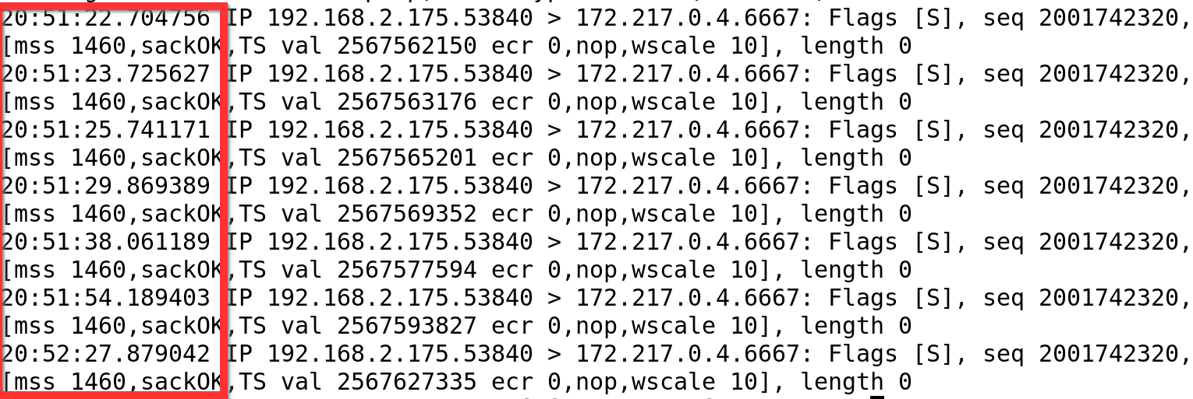
TCP - Retransmission

Slide 42
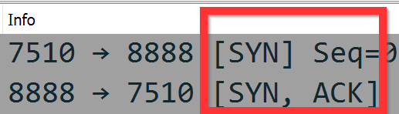
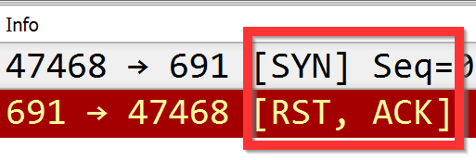
TCP – “Normal” Behavior
SYN to an open port causes SYN-ACK response
SYN to a closed port causes a RST
Notes:
SYN with no response means blocked (firewall, IPS?)

Slide 43
Transport Layer - UDP
User Datagram Protocol
Unreliable delivery
Faster than TCP
Packet loss handled at the application layer
Suitable for streaming (VOIP, video, etc)
DNS and tftp commonly use UDP
QUIC uses UDP
Notes:
Good that IP is unreliable, so it supports UDP

Slide 44
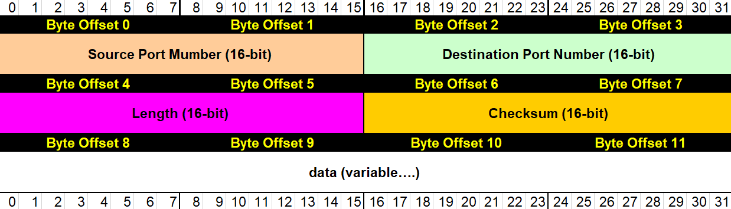
UDP Header
http://wiki.gnhlug.org/twiki2/pub/Www/IpReference/Packet_Headers_Subnet_Breakdown.xls

Slide 45
Transport Layer - ICMP
Internet Control Message Protocol
Administrative communication
Ping, unreachable messages, router advertisement, redirection, etc.
Often result from a stimulus
Ping response
Port unreachable

Slide 46
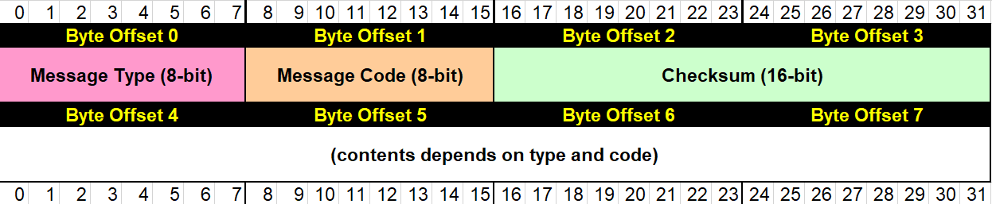
ICMP Header
http://wiki.gnhlug.org/twiki2/pub/Www/IpReference/Packet_Headers_Subnet_Breakdown.xls

Slide 47
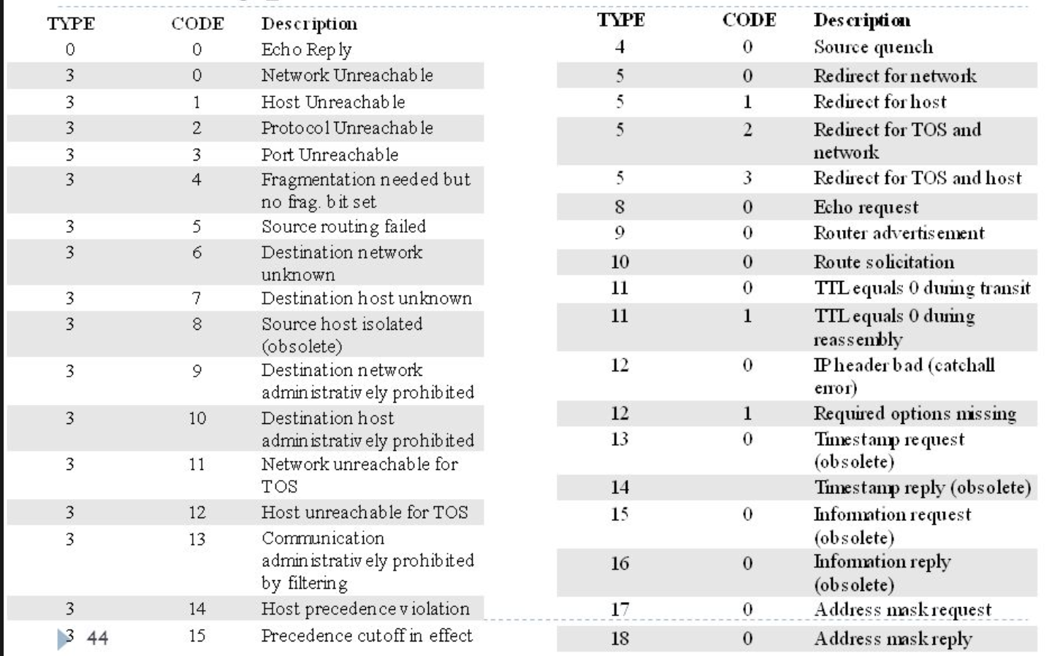
ICMP Header
http://slideplayer.com/slide/6252793/

Slide 48
ICMP Anomalous Traffic
Response with no stimulus
ICMP echo responses with no request
Different numbers of ICMP echo requests and responses
Nonstandard payloads
Windows echo request abcdefghijklmnopqrstuvwabcdefghi
Linux echo request !"#$%&'()*+,-./01234567

Slide 49
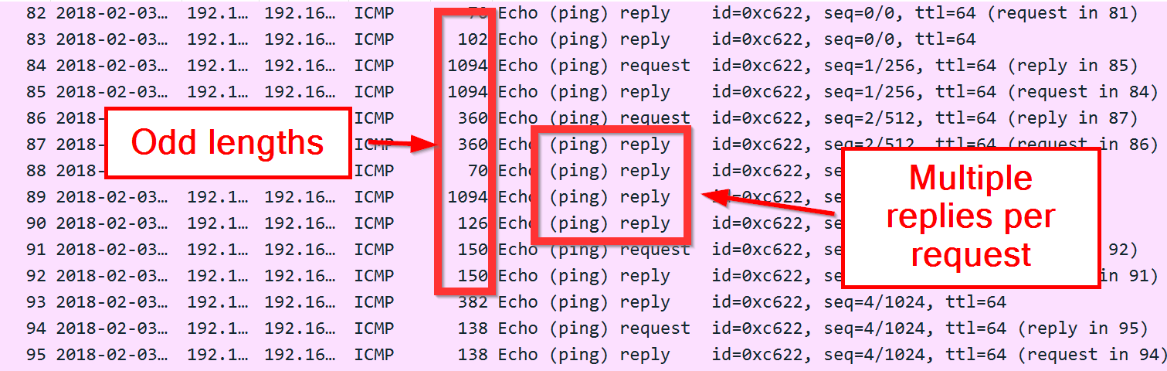
ICMP Tunnel

Slide 50
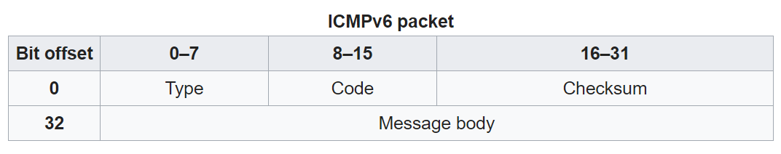
Transport Layer – ICMPv6
Internet Control Message Protocol
Same purpose as ICMPv4
Additional responsibility – Neighbor Discovery Protocol

Slide 51
Knowledge Check
What ICMP type and code indicate a ping response?
What two bytes start most IPv4 packets?
What ICMP type might indicate a traceroute?
What are the steps to the TCP 3-way handshake?
What are the two common methods of terminating a TCP connection?

Slide 52
Knowledge Check
What ICMP type and code indicate a ping response?
Type 0, code 0
What two bytes start most IPv4 packets?
0x4500
What ICMP type might indicate a traceroute?
Type 11
What are the sets of flags in a normal TCP 3-way handshake?
SYN, SYN-ACK, ACK
What are the two common methods of terminating a TCP connection?
FIN, RST

Slide 53
Part 2 – Tools

Slide 54
Overview Part 2 – Tools
TCPDump
Wireshark
TShark
ngrep
GNU Tools

Slide 55
TCPDump
Packet sniffing application
*nix, windump on Windows
Little interpretation past transport layer
Fastest sniffer available
Uses Berkeley Packet Filters (BPF)

Slide 56
TCPDump Common Options
-nn : Do not resolve host names or ports
-i : Capture interface
-w : write packets to a file
-r : read capture file
-A : Dump ASCII
-x : Dump hex
-X : Dump hex and ASCII
-v[vvvv] : increase verbosity

Slide 57
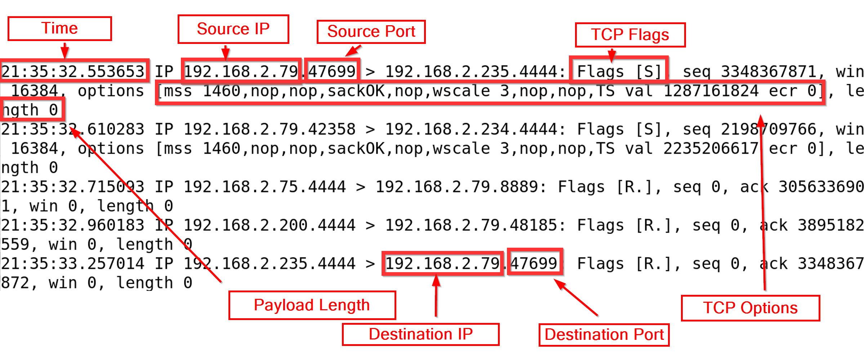
TCPDump
Notes:
Ack packet shows up as a . In TCP flags!

Slide 58
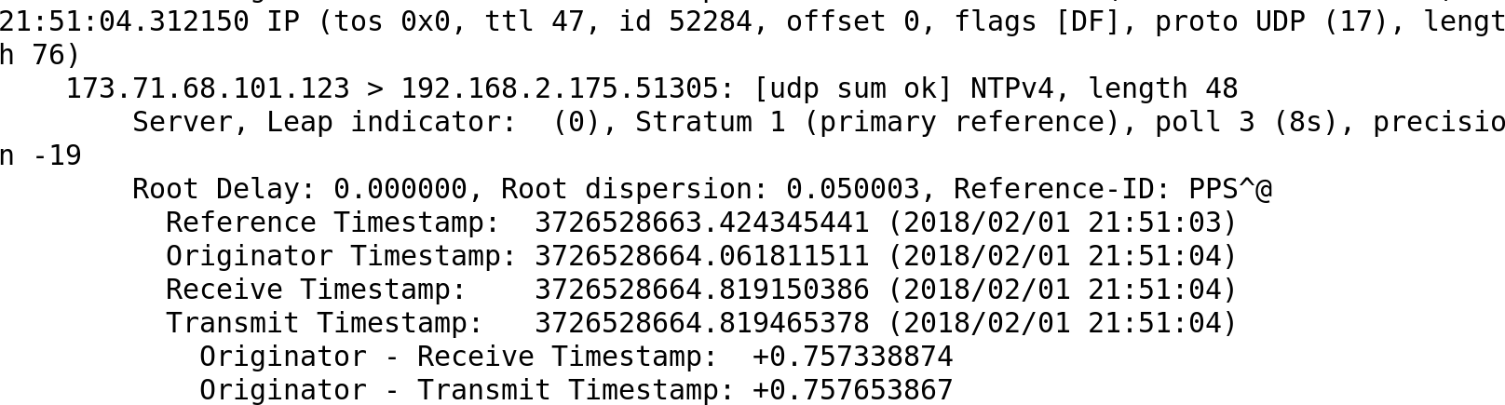
TCPDump Verbose Output

Slide 59
Berkeley Packet Filters
Widely used in networking tools
Limit traffic TCPDump accepts
Allows targeted captures
Filter existing captures

Slide 60
Berkeley Packet Filters
host host : capture traffic from a specific host
src host host : specific source host
dst host host : specific destination host
ip src host host : IP packets from specific source host
Port port : Packets to or from a specific transport-layer port
ether ehost : packets from a specific MAC
net subnet : packets to or form a specific subnet

Slide 61
Berkeley Packet Filters
ip[0] = 0x45 : IPv4 packets, header length 20
tcp[2:2] = 443 : TCP packets destination port 443
tcp : capture all TCP packets
udp : capture all UDP packets
tcp && src host host : TCP packets from a specific host
tcp || src host host : Any TCP packet or packet from a specific host

Slide 62
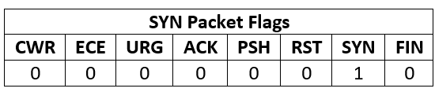
TCP Flags (Byte 13)
Byte 13 in the TCP header contains control flags
Help manage the TCP conversation

Slide 63
Berkeley Packet Filters
tcp[13] = 0x02 : SYN packets
tcp[13] = 0x04 : RST packets
tcp[tcpflags] = tcp-syn : also SYN packets
How can you capture packets without the SYN flag set?

Slide 64
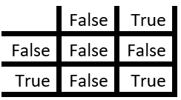
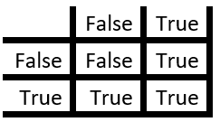
Bit Masking
Logical AND (&)
Both statements must be true
Logical OR (|)
Either statement is true

Slide 65
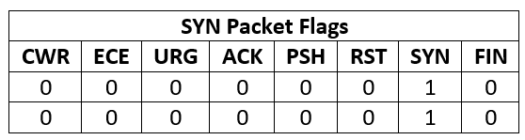
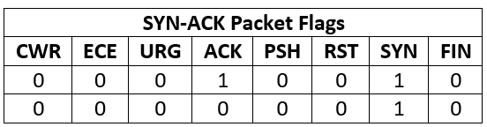
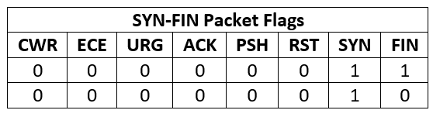
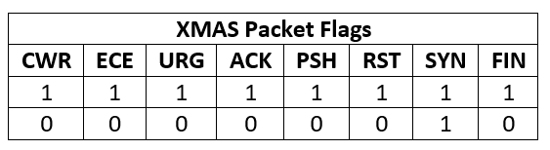
Berkeley Packet Filters
Packets with the SYN flag set
tcp[13] & 0x02 == 0x02

Slide 66
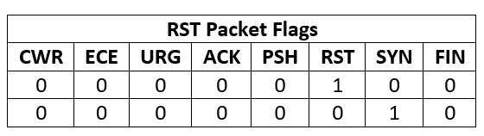
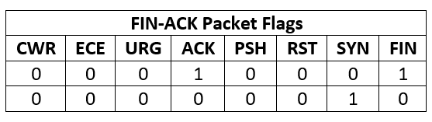
Berkeley Packet Filters
Packets without the SYN flag set
tcp[13] & 0x02 != 0x02
tcp[13] & 0x02 = 0

Slide 67
Knowledge Check
Find SYN-ACK packets
Find packets with a source port of 80
Find packets with all TCP flags set
Find all UDP packets with a destination port of 123
Find all type 3 code 3 ICMP packets

Slide 68
Knowledge Check Answers
Find SYN-ACK packets
tcp[13]=0x12
Find packets with a source port of 80
src port 80
udp[0:2]=80 || tcp[0:2]=80
Find packets with all TCP flags set
tcp[13]=0xff
Find all UDP packets with a destination port of 123
udp[2:2]=123
udp && dst port 123
Find all type 3 code 3 ICMP packets
icmp[0]=3 && icmp[1]=3

Slide 69
Wireshark
Not as confusing as TCPDump
Graphical interface to view packets
Robust application layer support
More powerful filters
Slow.
Can be misleading
Almost unusable > 1GB packet captures
Can have remote code execution vulnerabilities

Slide 70
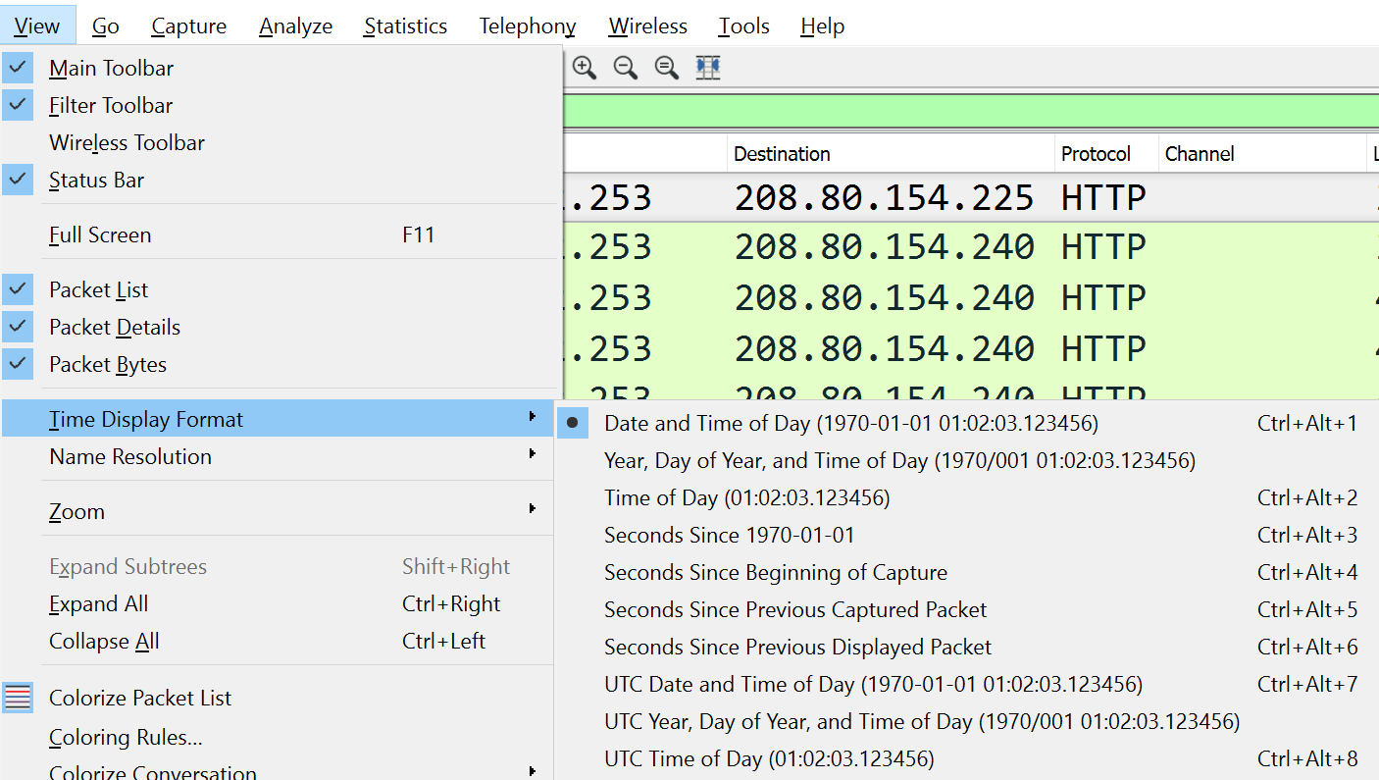
Wireshark – Time Display

Slide 71
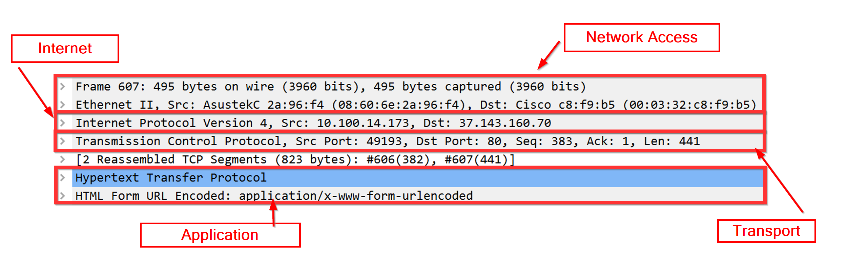
Wireshark

Slide 72
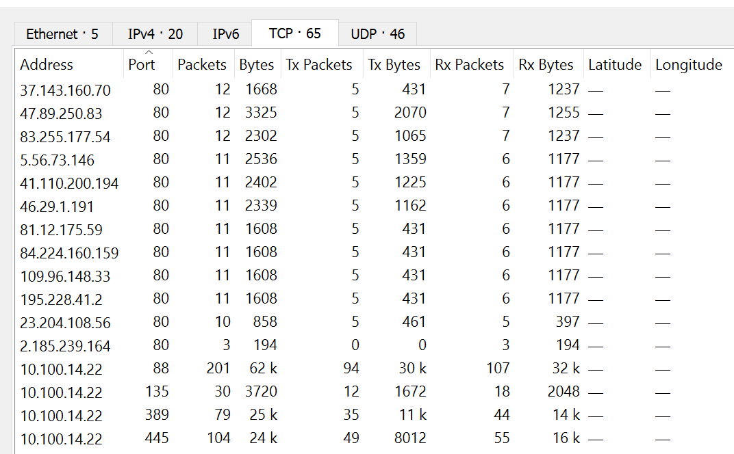
Wireshark Statistics

Slide 73
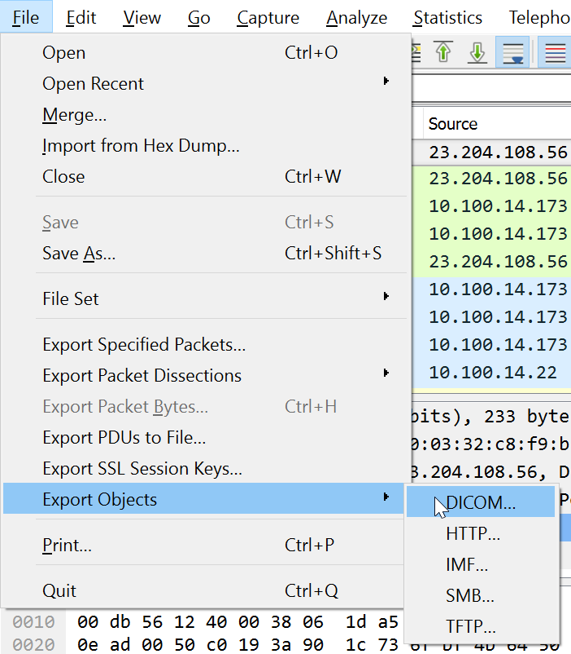
Wireshark Exports
Dump files from pcaps
File | Export Objects
Limited protocol support
HTTP
SMB
DICOM
IMF
TFTP

Slide 74
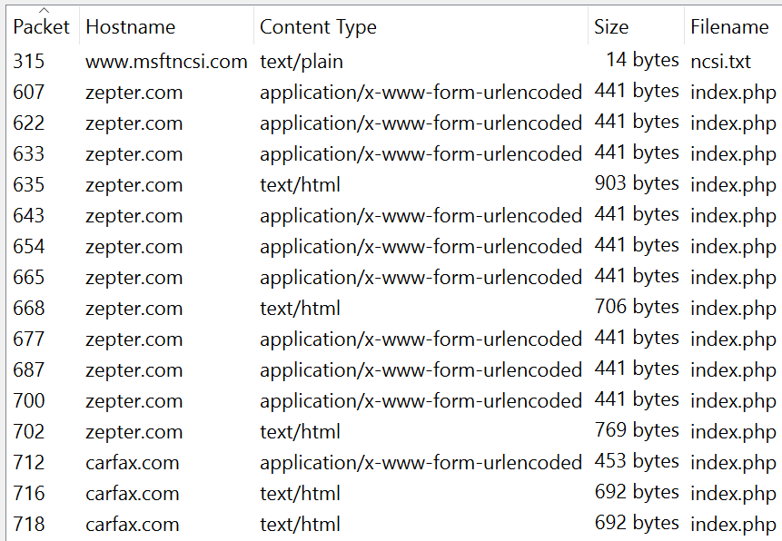
Export Objects

Slide 75
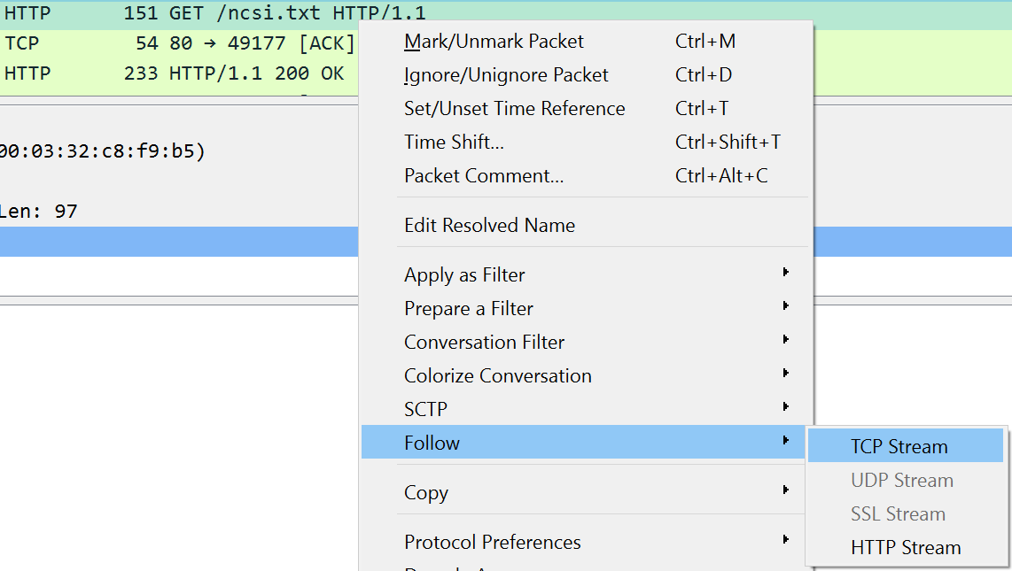
Wireshark Follow TCP Streams
Limits displayed packets to a specific set
Can use to export alternate protocols

Slide 76
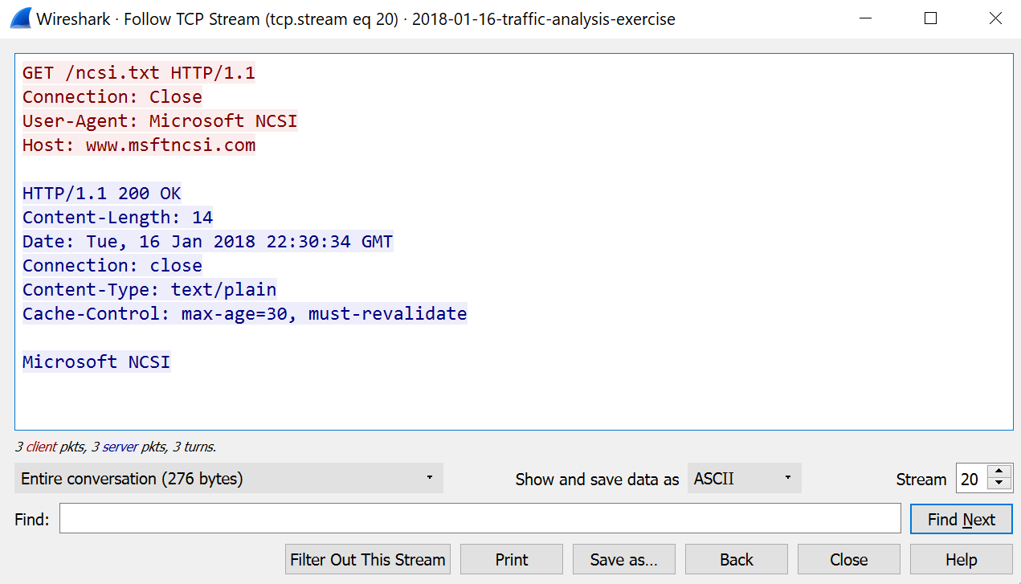
Followed TCP Stream - HTTP

Slide 77
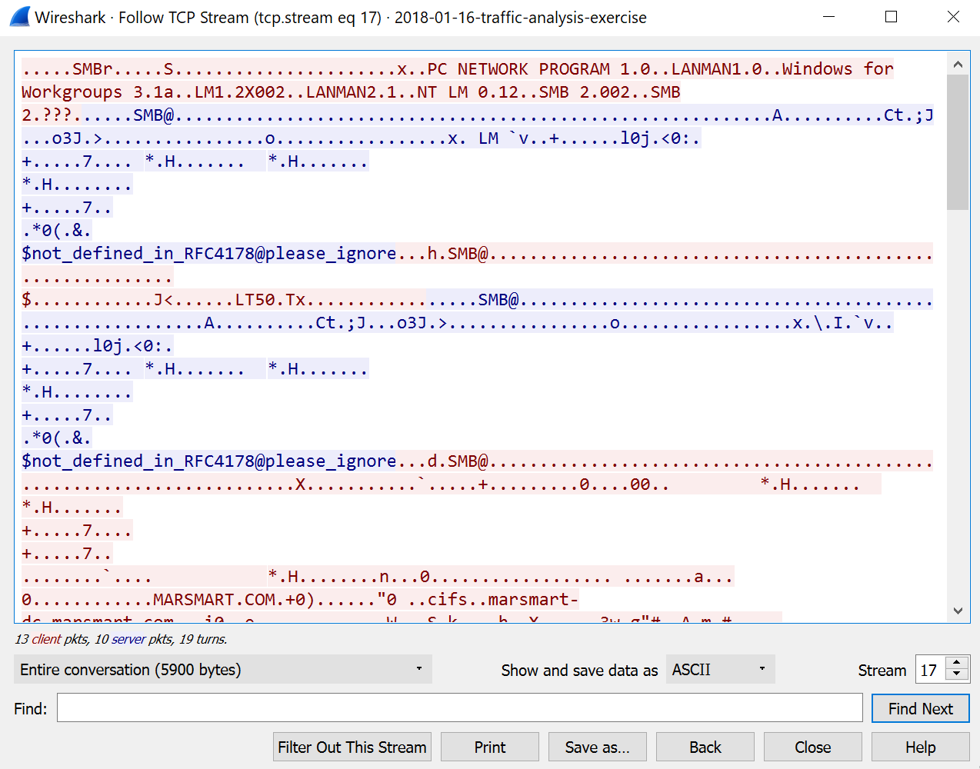
Followed TCP Stream - SMB

Slide 78
Wireshark Filters
Capture Filters
Use BPF to limit traffic collected
Display Filters - SLOW
Wireshark-specific language
Limit traffic displayed
Does not alter capture file
Intellisense

Slide 79
Wireshark Display Filters
Equality & comparison
Numeric : ==, !=, <, <>, >, <=, >=
String : eq, ne, lt, gt, le, ge
contains
matches
Logical operators
&&, ||, !
and, or, not
Parenthetical notation
Use parenthesis to group logic statements

Slide 80
Common Wireshark Display Filters
ip.addr == host
ip.src == host
http.request.full_uri contains “string”
ip.addr == host && (dns || http.request.full_uri || ssl.handshake.certificate)
tcp.port == port
!(ip.addr == host)

Slide 81
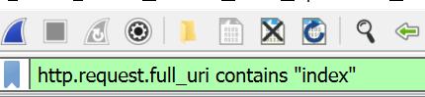
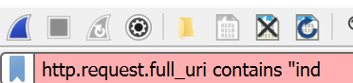
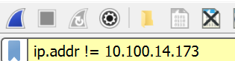
Display Filters Interface
Working filter
Broken filter
Insane filter

Slide 82
TShark
Command line interface to Wireshark
Supports display filters
Far faster
Supports file exports (recent versions)
Parse with text-based tools
Slower than tcpdump, but more functional

Slide 83
TShark Command Line Switches
-r : read pcap file
-nn : do not resolve ports and hosts
-Y : display filter
-T : format output
-e : specify fields
-w : write packets to file
--export-objects : export objects of specified protocol to specified directory

Slide 84
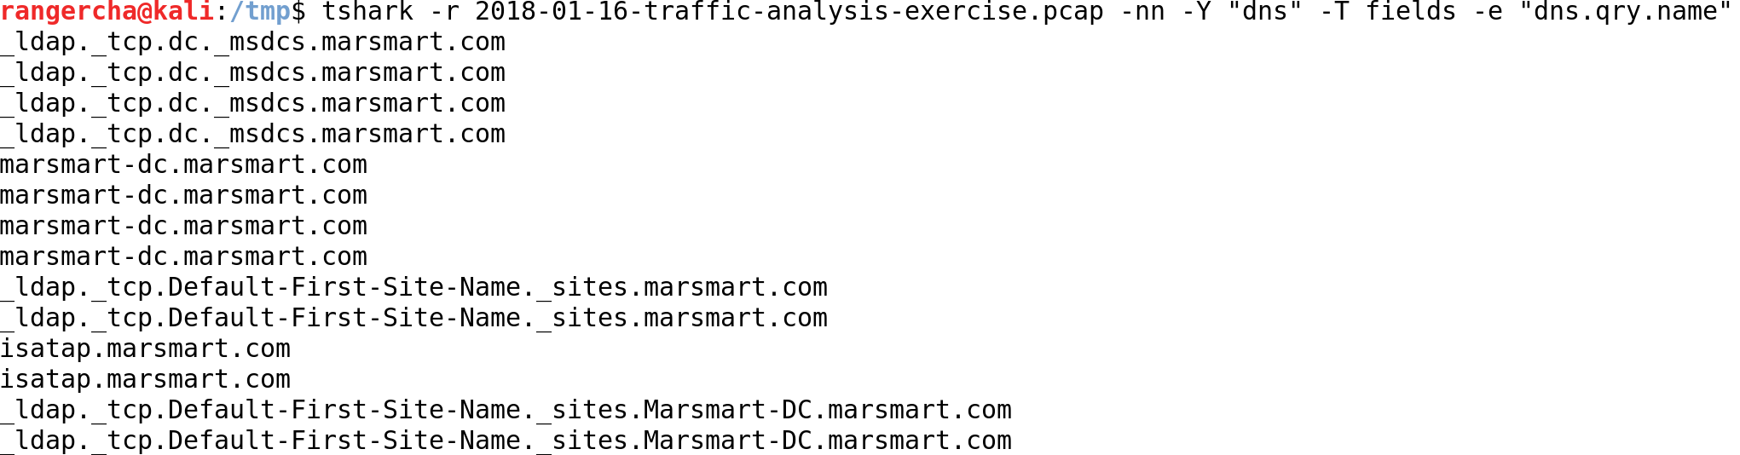
TShark Command Line Switches

Slide 85
TShark Command Line Switches

Slide 86
TShark Output Fields
Separate multiple fields into separate –e arguments
tshark -r filename.pcap -T fields -e 'http.request.full_uri' -e 'http.referer' -Y 'tcp.port==80’
I would not call it complete…
Some fields are blank for no reason
List of all possible fields
https://www.wireshark.org/docs/dfref/
icmp.data
http.request.full_uri
http.referer

Slide 87
Ngrep
Find packets matching a regex
grep, but for packets
Why not use grep?
Need to know the packet information
Command line switches
-qI : suppress hash marks, read from file

Slide 88
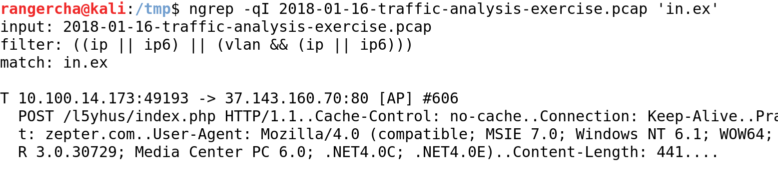
Ngrep

Slide 89
Text Parsing
Find, massage, and present text
One of the best skills to have
Not just for packet analysis
Linux-based tools
Also have windows versions

Slide 90
Output Redirection
stdin, stdout, stderr
| : direct stdout to stdin
> : direct stdout to file
>> : direct stdout append to file
< : direct file to stdin
2>&1 : direct stderr to stdout

Slide 91
Cut
Splits input into columns
Outputs selected columns
Bad for reordering
Splits on arbitrary characters
Beware of repeating characters
Switches
-f field_number : select specified fields
-d ‘delimiter’ : use specified delimiter to split

Slide 92
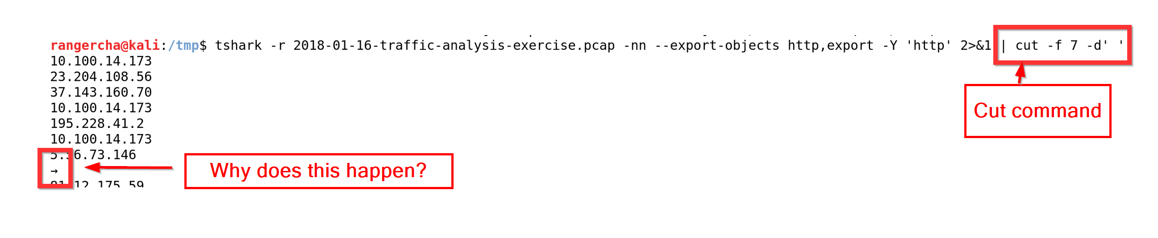
Cut
Notes:
Run without cut
tshark -r 2018-01-16-traffic-analysis-exercise.pcap -nn -Y 'http' 2>&1 | cut -f7 -d’ ‘
Spaces in output

Slide 93
Translate - tr
Replaces single character
tr ‘a’ ‘b’ : replace a with b
tr -s ‘ ‘ : squeeze repeating characters
tr -d ‘:‘ : delete character
Very handy before cut

Slide 94
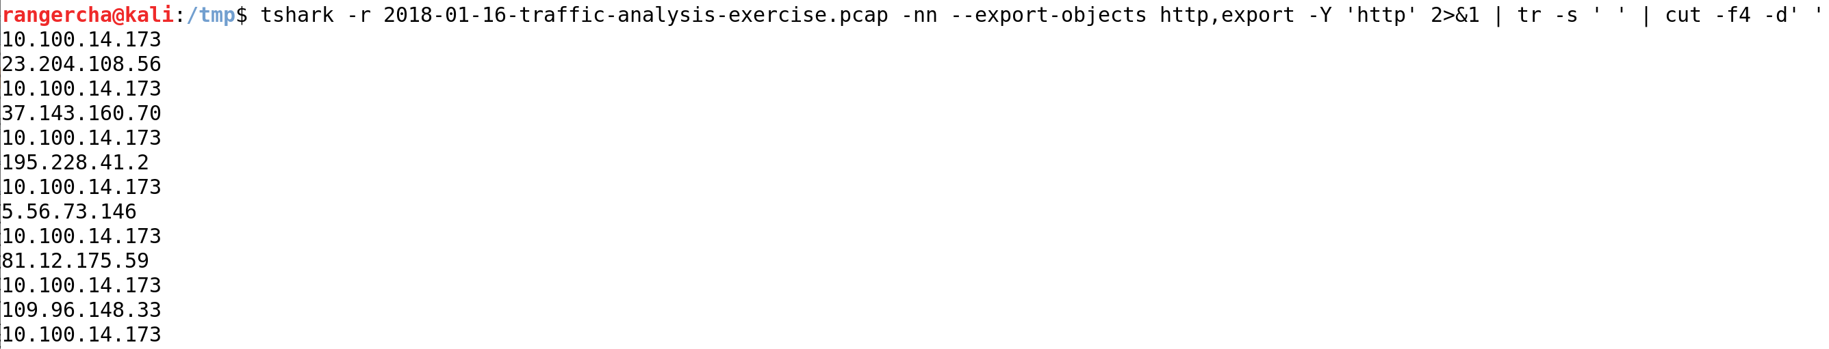
Tr with Cut

Slide 95
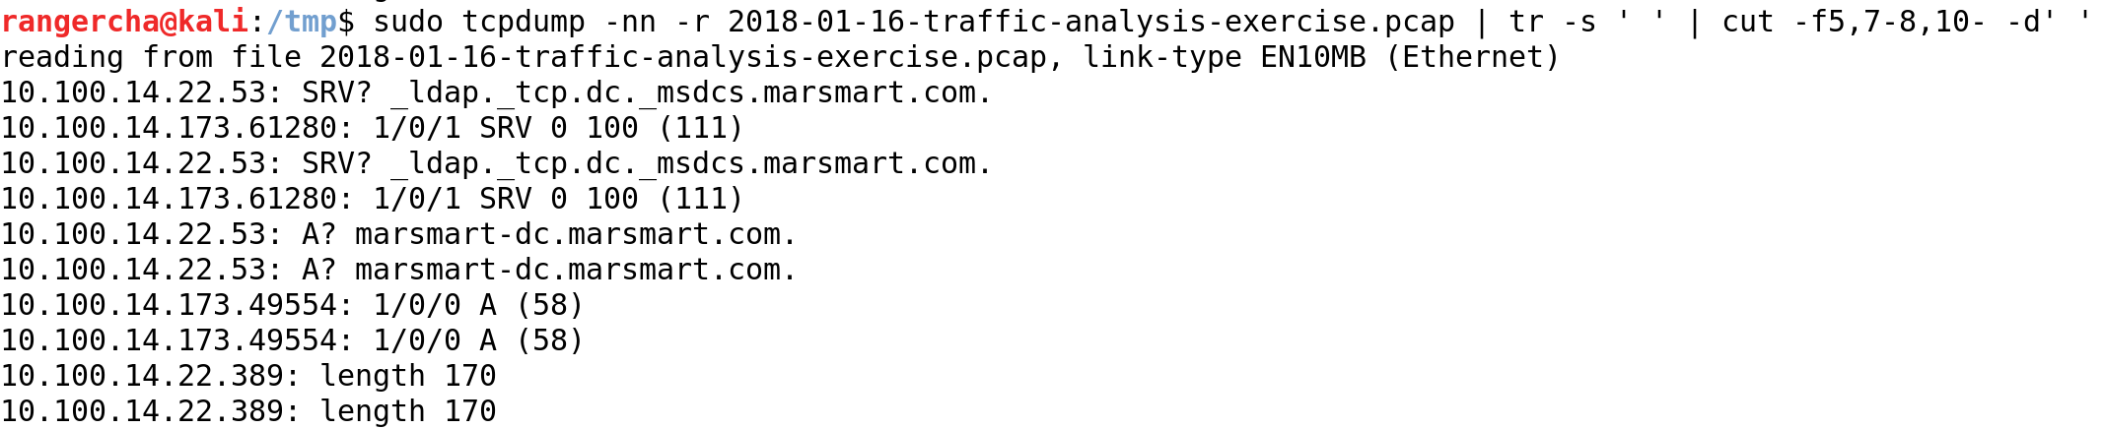
Cut Multiple Columns
cut -f5,7-8,10- -d’ ‘
cut columns 5, 7 through 8, 10, and all columns after 10, delimited by space

Slide 96
Sort
Orders text
Alphabetical or numeric
-n : numeric sort
Can reverse sort
-r : reverse sort
Needed for aggregation

Slide 97
Output Chain
| tr -s ' ' | cut -f5 -d' ' | cut -f5 -d'.' | tr -d ':' | sort
Squeeze spaces
Get column 5, space delimited
Get column 5, period delimited
Delete the : character
Sort output

Slide 98
Unique - uniq
Aggregates repeating lines
Can provide a count with –c
Sort first

Slide 99
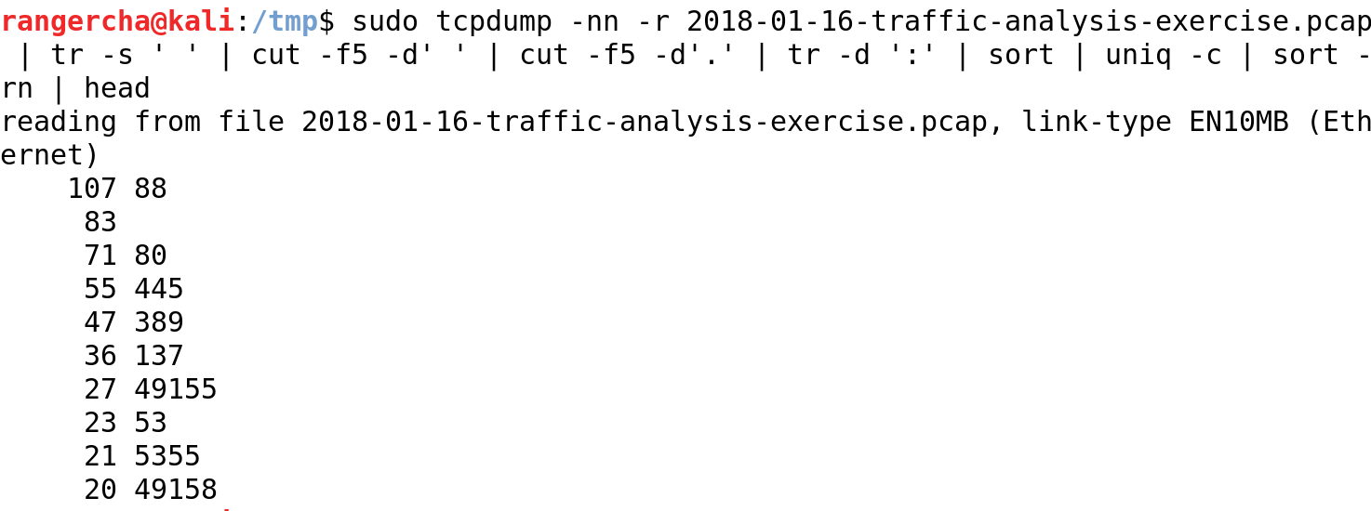
Get Top 10 Destination Ports

Slide 100
Head & Tail
head -n number
Get top number rows (default 10)
tail -n number
Get last number rows (default 10)

Slide 101
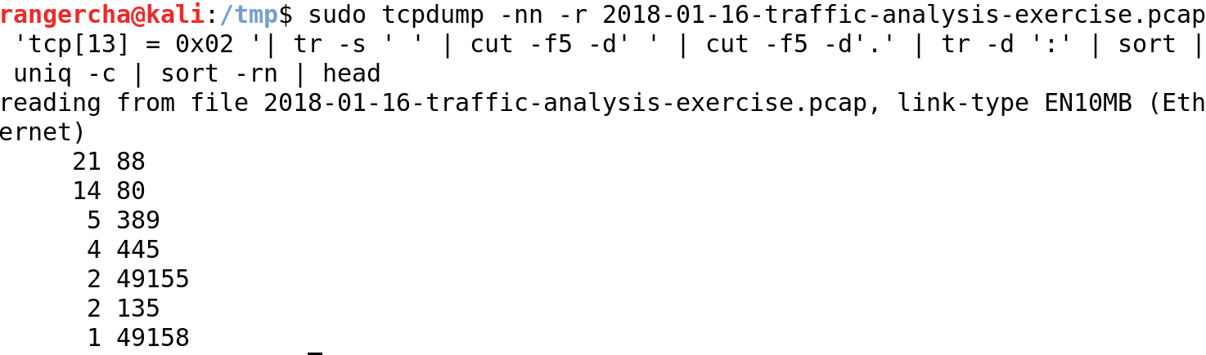
Get Top 10 Destination Ports – New Connections

Slide 102
Word / Line Count
wc
wc -l
Count lines
Answer “how many ports” and “how many hosts” questions

Slide 103
Decoding
xxd
Decode ASCII to hex and hex to ASCII
xxd -r -p
Hex to ASCII
Base64
Encode/decode base64 encoded content
Decode: base64 -d
Encode: base64 -e

Slide 104
Practical Exercise - Fragmentation
frags.pcap
Why might only 1 host have responded to the ICMP echo request?
frags2.pcap
What was the server’s response code?
What URL was probably requested?

Slide 105
Practical Exercise - Scanning
nmap.pcap
Which host was performing scanning?
Which host was the scan target?
How many TCP ports were scanned?
How many UDP ports were scanned?
Which TCP ports were open?
What may have caused the scan behavior after 12:04:10?

Slide 106
Practical Exercise – Fragmentation Answers
frags.pcap
Why might only 1 host have responded to the ICMP echo request?
Fragmented ICMP blocked by Google, but not by local router
frags2.pcap
What was the server’s response code?
301
What URL was probably requested?
www.google.com

Slide 107

Practical Exercise – Scanning Answers
nmap.pcap
Which host was performing scanning?
192.168.2.175
tcpdump -r nmap.pcap -nn 'tcp[13]=0x02' | cut -f3 -d' ' | cut -f1-4 -d '.' | sort | uniq -c | sort -n

Slide 108

Practical Exercise – Scanning Answers
nmap.pcap
Which host was the scan target?
192.168.2.75
tcpdump -r nmap.pcap -nn 'tcp[13]=0x02' | cut -f5 -d' ' | cut -f1-4 -d '.' | sort | uniq -c | sort –n

Slide 109
Practical Exercise – Scanning Answers
nmap.pcap
How many TCP ports were scanned?
1000
sudo tcpdump -r nmap.pcap -nn 'tcp[13]=0x02 && src host 192.168.2.175 && dst host 192.168.2.75'| cut -f 5 -d' ' | cut -f5 -d'.'| cut -f1 -d':' | sort | uniq | wc –l
How many UDP ports were scanned?
30
sudo tcpdump -r nmap.pcap -nn 'udp && src host 192.168.2.175 && dst host 192.168.2.75'| cut -f 5 -d' ' | cut -f5 -d'.'| cut -f1 -d':' | sort | uniq | wc -l

Slide 110

Practical Exercise – Scanning Answers
nmap.pcap
Which TCP ports were open?
1025,1026,1027,1031,1032,1034,135,139,2869,3306,445,5357
sudo tcpdump -r nmap.pcap -nn 'tcp[13]=0x12 && dst host 192.168.2.175 && src host 192.168.2.75'| cut -f 3 -d' ' | cut -f5 -d'.'| cut -f1 -d':' | sort | uniq

Slide 111

Practical Exercise – Scanning Answers
nmap.pcap
What may have caused the scan behavior after 12:04:10?
Firewall enabled that does not reset connections

Slide 112
Part 3 – Common Protocols

Slide 113

Overview Part 3 – Common Protocols
HTTP
SSL
ARP (not app layer)
DNS
FTP

Slide 114
HTTP
Extremely common
Source of most infections
Often permitted through firewalls
Use 2015-08-31-traffic-analysis-exercise.pcap for examples (from malware-traffic-analysis.net)

Slide 115

HTTP Request

Slide 116

HTTP Response

Slide 117
Important HTTP Response Headers
“Referer”
Tells which page caused the current request
May be blank if referred from HTTP to HTTPS
Location
30X responses send user to “Location” header value
Content-Type
Tells how to interpret server response

Slide 118
HTTP Redirection
Only certain ways to load content
30X response code
iframe
script
meta refresh
http://ranger-cha.blogspot.com/2015/02/following-trail-http-referer-header.html

Slide 119

HTTP Forensics
Starting from an alert…

Slide 120

HTTP Forensics
Use source port

Slide 121

HTTP Forensics
Follow TCP stream

Slide 122

HTTP Forensics
Find iframe

Slide 123


HTTP Forensics

Slide 124

HTTP Forensics

Slide 125
HTTP Forensics
After finding the exploit, work backwards from the alert

Slide 126

HTTP Forensics

Slide 127
HTTP Forensics
What happened?
User went to google
Clicked on a link
web.feeddigest.com
302 redirect to vitaminsthatrock.com
iframe to vclphjybj.ioxbpjgtqvwqfzmwhn.ga:13390
Loaded flash exploit

Slide 128
HTTP Forensics
Why bother?
Effective blocks
Supply malware analysis teams
Effective threat intelligence
Build statistics
Notify compromised sites

Slide 129
SSL
Becoming more common
Uses public key infrastructure (PKI)
Encrypts other protocols (often HTTP)
Can authenticate the client, but not common
Often permitted through firewalls
ssl_pcap_example.pcap

Slide 130
SSL Connection Steps
TCP handshake
Client hello (supported protocols & cipher suites)
Server cert & key exchange (selected protocol & cipher suite)
Client session key & change cipher spec

Slide 131

SSL Handshake in Wireshark

Slide 132
SSL – What do we know?
Client supported protocols and cipher suites
Client public key if used
Server selected protocol and cipher suite
Server public certificate
May have site name in cert

Slide 133
SSL Decryption
Need to decrypt the session key
Does not work with Diffie-Hellman key exchange
Client encryption info is ephemeral
Can enable SSL key logging in browser
Server private key can decrypt

Slide 134

SSL Decryption

Slide 135

SSL Decryption

Slide 136
Address Resolution Protocol (ARP)
Resolve MAC address to IP address
Stays within broadcast domain
Request and response packets
No security
Allows MitM

Slide 137

Address Resolution Protocol (ARP) Format
Hardware Type (Word)
Protocol Type (Word)
Hardware Size
(Byte)
Protocol Size
(Byte)
Opcode
(Word)
Sender MAC
(6 Bytes)
Sender IP
(4 Bytes)
Target
MAC
(6 Bytes)
Target IP
(4 Bytes)

Slide 138

Address Resolution Protocol (ARP)

Slide 139
Domain Name Service (DNS)
Resolves host names to IP addresses
Often occurs before malicious traffic
Also used for data exfiltration
Usually UDP 53
Can be TCP 53

Slide 140

DNS Query Header
https://technet.microsoft.com/en-us/library/bb962025.aspx

Slide 141

DNS Response Header
https://technet.microsoft.com/en-us/library/bb962025.aspx

Slide 142

DNS Recursion

Slide 143

DNS Odd Behavior

Slide 144
File Transfer Protocol
Plaintext protocol for transferring files
May be wrapped in SSL (FTPS)
Not to be confused with SFTP (SSH file transfer)
USER command to send username
PASS command to send password
Two types of FTP, active and passive

Slide 145
Active Mode FTP
Client connects to server on port 21 (command channel)
Client gives server an ephemeral port for data (data channel)
Server connects back to client on data channel (ephemeral source and destination)

Slide 146

Active Mode FTP

Slide 147
Passive Mode FTP
Client connects to server on port 21 (command channel)
Server gives client an ephemeral port for data (data channel)
Client connects to server on data channel (source port 20)

Slide 148

Passive Mode FTP

Slide 149
Part 4 – Scapy

Slide 150
Scapy
Python packet crafting library
Written by Philippe Biondi
Slow, but simple
Not great for broad scanning
Helpful for simulating odd behavior
Allows complex sequences of packets

Slide 151
Scapy
Define each layer of a packet
Ping localhost
testpacket = IP(dst="127.0.0.1")/ICMP()
Connect to Bing on port 80 TCP
testpacket = IP(dst=”www.bing.com”)/TCP(dport=80)/”GET / HTTP/1.1\n\n”
Not going to work great
Data on SYN
Networking stack will reset the connection

Slide 152

Scapy – useful commands
ls(): list all object members

Slide 153

Scapy – useful commands
object.summary: list non-default field values

Slide 154
Scapy – useful commands
Resp, noresp = sr(testpacket)
Send packet, match responses. Store responses in resp, unanswered packets in noresp
sr1(testpacket)
Send packet, match single response
send(testpacket)
Send packet, do not look for responses

Slide 155
Scapy – notes
Native networking stack may get confused
Diagnose with tcpdump
Use iptables to prevent it
iptables --save >> iptables_original
iptables –A OUTPUT –p tcp –tcp-flags RST RST –j DROP
Fix using iptables --restore iptables_original or iptables --flush
Run Scapy as root

Slide 156
Part 5 – Analysis Tips

Slide 157
Common External Ports
Good egress filtering should block most external traffic
Permitted traffic should go through an intermediary
TCP:80 (HTTP)
TCP:443 (SSL)
UDP:123 (NTP)
Should be blocked
UDP:53 (DNS)

Slide 158
Common Internal TCP Ports
22 (SSH)
445 (SMB)
88 (Kerberos)
135 (DCE/RPC)
389 (LDAP)
636 (LDAPS)
993 (IMAPS)

Slide 159
Common Internal TCP Ports
80 (HTTP)
443 (HTTPS)
8080 (Alternate HTTP)
8443 (Alternate HTTPS)
Ephemeral ports (RPC)

Slide 160
Common Internal UDP Ports
53 (DNS)
5355(LLMNR)
123(NTP)
514(SYSLOG)

Slide 161
Alerts
Many sources
Intrusion Detection System
Intrusion Prevention System
Web Application Firewall
Signatures are not always great
Places to start
Use the source port

Slide 162
Continued Analysis
Work forward for post infection
Find binary files for analysis
Identify command and control traffic
Work backward to find the origin
Often starts with legitimate sites

Slide 163
Useful Techniques
Wireshark display filters
dns || http.request.full_uri || ssl.handshake.certificate
Find “odd” URLs
Long alphanumeric strings that are not words
Directed outside of domain
Use “referer” to work backwards
Find redirection call in calling page (URL string)

Slide 164
Automated Tools
Virustotal.com
Binaries or pcaps
Sandboxes
https://zeltser.com/automated-malware-analysis/

Slide 165
More Training
https://malware.dontneedcoffee.com/
https://contagiodump.blogspot.com/
https://www.malware-traffic-analysis.net/
https://www.root-me.org/

Slide 166
Part 6 – Practical Exercise

Slide 167
ch2.pcap (from root-me.org)
Find the FTP password

Slide 168
ch3.pcap (from root-me.org)
Find the twitter password

Slide 169
2015-03-24-traffic-analysis-exercise.pcap (from malware-traffic-analysis.net)
IP address of the infected host
Which server is probably legitimate, but compromised?
What redirection techniques does this exploit kit use?
What malware was used?

Slide 170
sansholidayhack2013.pcap (from the SANS holiday hack challenge, 2013)
What are the MACs and IPs of the machines that ARP cache poison? Is it successful?
What are the IPs of the systems that were port scanning?
What systems and protocols did the scan discover?
What account was used in an attack over the SMB protocol?

Slide 171
packet_intro.pcap
What are the max and minimum SSL/TLS versions supported by 192.168.2.122?
Find the 7 flags

Slide 172
Part 7 – Practical Exercise Answers

Slide 173

ch2.pcap
Find the FTP password
ngrep for PASS

Slide 174

ch3.pcap
Find the twitter password
ngrep -qI ch3.pcap 'Authorization: Basic' | tr ':' '\n' | grep 'Basic' | cut -f3 -d' ' | cut -f1 -d'.' | base64 –d

Slide 175
2015-03-24-traffic-analysis-exercise.pcap
IP address of the infected host
192.168.122.200
Which server is probably legitimate, but compromised?
forums.pelicanparts.com
What redirection techniques does this exploit kit use?
Script tag injection
What types of exploits were served?
Adobe Reader, Flash, Java, Silverlight

Slide 176
sansholidayhack2013.pcap
What are the MACs and IPs of the machines that ARP cache poison? Is it successful?
00:0c:29:f7:f4:9a - 10.21.22.253 - successful
10.25.22.252 - unsuccessful
What are the IPs of the systems that were port scanning?
10.25.22.252,10.21.22.253,10.25.22.253
tcpdump -nn -r sansholidayhack2013.pcap 'tcp[13]=0x02' | cut -f3,5 -d' ' | tr ' ' '.' | cut -f1-4,6-10 -d'.' | sort | uniq -c | sort -rn
tcpdump -nn -r sansholidayhack2013.pcap 'tcp[13]=0x14' | cut -f5 -d' ' | cut -f1-4 -d'.' | sort | uniq -c | sort -n

Slide 177
sansholidayhack2013.pcap
What systems and protocols did the scans discover?
tcpdump -nn -r sansholidayhack2013.pcap 'tcp[13]=0x12 && (dst host 10.25.22.252 || dst host 10.21.22.253 || dst host 10.25.22.253)' | cut -f3 -d' ' | sort | uniq

Slide 178
sansholidayhack2013.pcap
10.16.11.5.110 | 10.25.22.22.80 | 165.254.158.56.80 | 208.80.154.234.80
10.21.22.22.502 | 10.25.22.23.80 | 173.194.43.47.443 | 208.80.154.240.80
10.21.22.23.502 | 10.25.22.250.80 | 192.190.173.45.80 | 216.22.25.175.80
10.21.22.24.502 | 10.25.22.30.80 | 192.204.3.75.80 | 54.230.49.239.80
10.21.22.253.1225 | 10.25.22.58.4444 | 199.7.57.72.80 | 63.245.217.36.80
10.2.2.2.8081 | 10.25.22.58.445 | 208.80.154.224.80 | 69.16.175.10.80
72.167.239.239.80 | 74.125.226.239.443 | 82.103.140.42.443 | 74.125.226.228.80

Slide 179
sansholidayhack2013.pcap
72.21.195.198.443 | 74.125.226.242.443 | 10.25.22.22.44818
72.21.203.211.80 | 74.125.226.251.80 | 165.254.138.136.80
72.21.214.3.443 | 74.125.22.82.80 | 208.80.154.225.80
72.21.215.52.80 | 81.169.180.37.443 | 69.195.141.178.443
74.125.226.199.443 | 81.169.180.37.80 | 82.103.134.102.80

Slide 180
sansholidayhack2013.pcap
What account was used in an attack over the SMB protocol?
ernie

Slide 181
packet_intro.pcap
What are the max and minimum SSL/TLS versions supported by 192.168.2.122?
Max: TLS 1.2
Min: TLS 1.0

Slide 182

packet_intro.pcap

Slide 183

packet_intro.pcap
Flag 1
http.request.full_uri contains “flag”

Slide 184

packet_intro.pcap
Flag 2
ngrep -qI packet_intro.pcap ‘flag2’

Slide 185

packet_intro.pcap
Flag 3
ngrep -qI packet_intro.pcap 'flag3'

Slide 186
packet_intro.pcap
Flag 4
echo "flag" | base64
ngrep -qI packet_intro.pcap 'ZmxhZ’
ngrep -qI packet_intro.pcap 'ZmxhZ' | grep 'ZmxhZ' | tr -s ' ' | cut -f3 -d' ' | cut -f2- -d'=' | base64 -d

Slide 187

packet_intro.pcap

Slide 188
packet_intro.pcap
Flag 5
echo "flag5" | xxd -ps
ngrep -qI packet_intro.pcap '666c616735’
printf "666c6167353a6436386663373231646133316565663932663565373939616466643534653139" | xxd -r -p

Slide 189

packet_intro.pcap

Slide 190
packet_intro.pcap
Flag 6
tshark -r packet_intro.pcap -T fields -e icmp.type -Y 'icmp' | xargs printf '%x' | xxd -r -p

Slide 191

packet_intro.pcap

Slide 192
packet_intro.pcap
Flag 7
tcpdump -r packet_intro.pcap -nnA 'icmp' | grep '\.\.' | cut -f4 -d'-' | grep -v '@\.\.\.\.\.\.z' | tr -d '\n'

Slide 193

packet_intro.pcap

Slide 194
www.directdefense.com

